Slide 1

HARASSMENT IS…

Slide 2

What is Harassment?
Most people recognize that harassment occurs when someone openly bullies, threatens or even terrorizes another person. However, harassment isn’t always that obvious; it is often subtle in nature. A behavior doesn’t have to be intentional to be considered harassment. In fact, most people don’t consciously harass others. Harassment occurs when people are treated inappropriately or unfairly because they are perceived to be part of a protected group.
What are these protected classes:
Race, color, religion or creed, national origin or ancestry, age, sex (including pregnancy, sexual orientation or gender identity), disability, genetic information, veteran status
Title VII of the Civil Rights Act of 1964
Prohibits workplace harassment and discrimination of employees

Slide 3
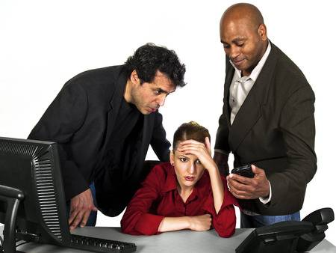
Harassment is about deciding to treat people respectfully or not!
“Hostile” does not necessarily mean behaving in an angry or violent manner
“Hostile” can mean being derogatory or saying or doing things that make another person feel inferior or uncomfortable.
Though one insensitive or derogatory comment is not usually considered harassment, this may not be true for highly offensive words or deeds.
Behavior is more likely to be deemed harassment when the offender is intentionally trying to make another person feel uncomfortable or intimidated.
In order for behaviors to be consider harassment, they must create a hostile work environment. A hostile environment results from behavior that is offensive and on going (pervasive). Telling one inappropriate joke might not be good common sense, but it is generally not considered harassment. However if your joke or other actions are offensive enough, you could be reprimanded or even fired.

Slide 4

REASONABLE PERSON STANDARD
While most people would never knowing harass another person, that doesn’t get them entirely off the hook. We all need to be especially careful about how others might perceive our actions or comments. What may not seem like harassment to one person could be offensive and demeaning to another. So who determines whether or not a behavior is harassment? The courts have ruled that the perception of the victim takes precedence over the intention of the accused. Since perception is what counts, it is important to determine if the perception is reasonable.
A person may not intend his or her comments or actions to harass, but if those actions had the reasonable effect of making another feel uncomfortable, humiliated, embarrassed, or unsafe in his or her working environment, a court could rule that the actions constitute harassment.
To evaluate the reasonableness of a person’s perception ask:
Would a reasonable person consider the behavior out of bounds?
Does the attention interfere with work?

Slide 5
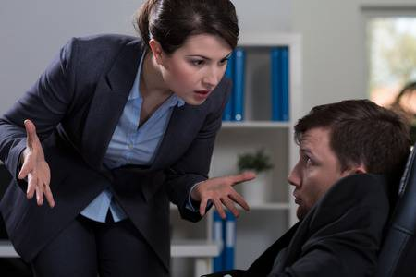
Harassment is costly to all involved. First, there is the large expense of dealing with a lawsuit. But even if there is no legal action taken, the expense is still high.
The Victim Often Feels Ask yourself
Pain Have I ever felt different from
Isolation the people around me?
Fear What was that like?
Frustration How did these feeling impact my ability to work?
The Company may experience
Decreases in production
Lowered morale
Increases in employee turnover
Loss of credibility in the community
These costs are hard to measure but they definitely affect the bottom line. The US Department of Labor has estimated that American businesses lose about $1 Billion annually in absenteeism, low morale and new employee training and replacement costs as a result of harassment.

Slide 6
If you are Feeling Harassed
Harassment is about respect. In every workplace, people should fee safe to contribute and be respected for the work they do. The key to preventing harassment is to understand what it is and how it affects others. The following guidelines are for helping prevent harassment in your workplace.
Demonstrate respect for co-workers.
Focus on an individuals ability to contribute, not his or her personality.
Honor a person’s right to do his or her job.
Think before you speak.
Be careful with jokes in the workplace. Avoid off-color humor.
Consider how a third party might perceive your actions or behavior.
Don’t let per pressure influence you to say or do things you wouldn’t normally do.
Comments that are appropriate at home or in another social setting may not be appropriate at work.
Think about the potential effects of your actions on others.
If you are feeling harassed:
If you are offended by someone’s comments or actions you have a responsibly to do something about it.
Talk to the offender. Tell him/her the specific behaviors that bothered you and ask him to stop
If the behavior continues, or if you don’t feel comfortable approaching the person, talk to your HR Manager
Follow your company guidelines for reporting harassment.

Slide 7
If you think you have offended someone
If you choose to address your concern directly with the offender and he or she is unaware of the offensive behavior:
Figuring out what constitutes offensive or harassing behavior isn’t easy these days. In general, you should stick to the motto “Better safe than sorry.”
If you think a comment or action could be taken the wrong way, don’t say it. If someone appears to be offended by something you have said or done, follow these two simple steps:
Apologize to the person you may have offended
Be careful not to repeat the behavior.
Remember that each of us reacts and interacts through our own biases
Help the person to understand how his or her behavior can be interpreted as harassment
Refer the person to organizations or community resources for counseling.
If you witness harassment
Ask yourself
Being a third party witness to harassment can be terribly uncomfortable. If you witness harassment:
Address your concern with the offender if possible
Follow company policies and procedures for reporting harassing behavior.
Have I ever witnessed harassing behavior?
What did I think about it and how did I feel?
What could I have done to help the situation?

Slide 8
Sexual Harassment
Verbal behavior:
Foul or obscene language, sexual propositions, sexual innuendos, crude jokes about gender specific traits, threats, discussing sexual activities, commenting on someone’s physical attributes or spreading false rumors about a person's sexual activity.
Although sexual harassment has decreased in the workplace due to growing awareness, it hasn’t disappeared. Sexual harassment is unwanted sexual attention that offends or harms the victim and often the general morale of the victim’s workplace. There are two kinds of sexual harassment.
“Hostile environment” sexual harassment occurs when constant sexual acts or behaviors create an offensive atmosphere that affects the victim’s ability to do his or her work. This by far the most common form of sexual harassment in today’s workplace. The following are examples of conduct that create hostile environments.
Nonverbal conduct:
Staring sexually, suggestive or obscene gestures or noises, displaying sexually explicit pictures or calendars, use of computer images that depict sexual situations, sexual graffiti, pornography, sexual cartoons, crude pranks, giving gifts or letters of a sexual nature.
Physical Acts:
Any form of inappropriate or unwelcome physical conduct such as unnecessary touching, grabbing, pinching, holding, hugging, kissing or blocking a person’s path.

Slide 9

Quid pro quo
The second kind of sexual harassment is called “quid pro quo” a term meaning “this for that”
Quid pro quo
Revolves around a tangible employment action such as:
Promotion or raise in exchange for sexual favors
Inflated performance evaluation
It can also occur when a superior punishes an employee for refusing to engage in the sexual conduct:
Loss of job
Blocked promotion
Demotion or transfer
Poor job performance evaluation
The harasser does not have to be the victim’s direct supervisor. Anyone in the organization with the apparent or real authority to affect the victim’s terms of employment can be guilty of committing quid pro quo sexual harassment.

Slide 10
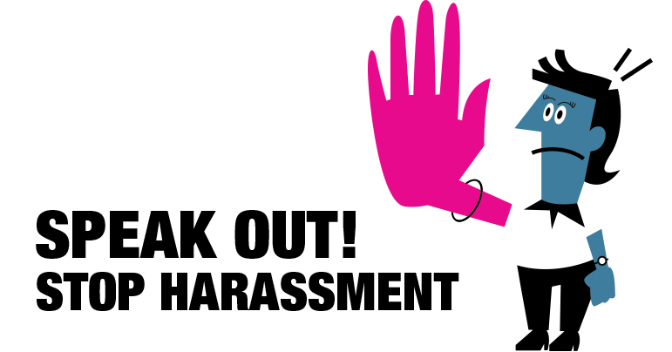
Summary
It’s everyone’s responsibility to prevent and eliminate harassment in the workplace. Here are some examples
Respect each person
Think before you speak
Avoid joking about sensitive topics
Report all incidents of harassment
Apologize if you offend someone
If we all do our part, we can eliminate harassment In the workplace

