Slide 1
HIPAA and Other Privacy Stuff…
By
Jennifer Carson and Tamra Catt
Rev. 9/2017

Slide 2

What is HIPAA?
Not HIPPA – this is a female hippopotamus that dances like a ballerina…
Notes:
presents a general overview of what HIPAA is and how it impacts you and your job. Attention to HIPAA confidentiality and security issues are important aspects of your job.

Slide 3

Seriously? What is HIPAA?
HIPAA stands for the Health Insurance Portability and Accountability Act of 1996
Developed to improve efficiency and effectiveness of healthcare systems by standardizing the electronic exchange of clinical and administrative data.
It aims to safeguard the confidentiality of private information and protect the integrity of health data while ensuring the availability of care.
Protected Health Information or PHI
Notes:
The Health Insurance Portability and Accountability Act (HIPAA) of 1996 is federal legislation enforcing:
The portability of health care coverage
The security and privacy of health information; and
An accounting of how individual health care information is handled and protected
When HIPAA came into being its main goals were;
Give individuals more control and access to their medical information.
Protect individually identifiable medical information from threats of loss or disclosure.
Simplify the administration of health insurance claims and lower costs.

Slide 4
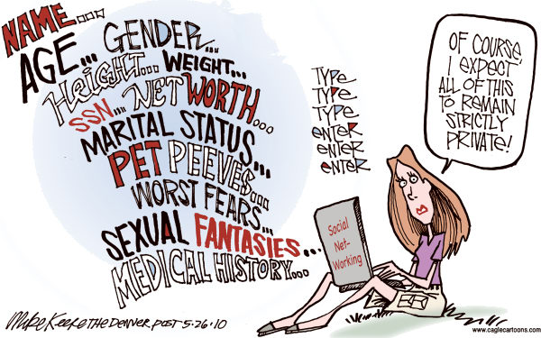

Slide 5
What is the HITECH Act?
HITECH – Health Information Technology for Economic and Clinical Health Act
Signed into law in 2009 with the final rule being passed January 2013
Protects electronic versions of PHI otherwise known as ePHI
Defines the Breach Notification Rule

Slide 6
Alaska Personal Information Protection Act
This became a state law in 2009.
Provides several protections for personal information including (ones pertaining to CCS):
A notice requirement when a breach of security concerning personal information has occurred
Various restrictions on the use of personal information and credit information
The disposal of records containing personal information
Personal information is defined to include information on an individual, that is not encrypted, that consists of the individual’s name and one or more of several pieces of information, including a social security number, driver’s license number, account number, password, or other access codes.

Slide 7

What does this all mean?
We need to consider that HIPAA and other privacy laws are meant to provide clients rights.
You need to consider how your actions in relation to the law provide the client the most rights.

Slide 8

Who’s Responsible for HIPAA

Slide 9

Let’s Dig In!
How does HIPAA and Privacy apply at CCS?
CCS considers personal information to be confidential and we will take necessary means to protect the privacy.
CCS’s Privacy Officer is responsible for the agency’s privacy program and assuring the agency is compliant with federal and state rules and regulation.
CCS’s Privacy Officer is Jennifer Carson
When in doubt –
Contact the Privacy Officer

Slide 10
What is Protected Information?
CCS has adopted the following definitions:
Protected Health Information (PHI)– any information, whether oral or recorded in any form or medium that is created by a healthcare provider, employer, etc. and relates to past, present or future physical or mental health or condition of the individual, the provision of health care to an individual, or the past, present or future payment for the provisions of healthcare. PHI consists of 18 different identifiers.
PHI retains the same protection for 50 years from the date of death.
Notes:
PHI refers to individually identifiable health information that is transmitted or maintained in any form or medium.
So to be clear:
HIPAA defines Protected Health Information as "any information whether oral, written or recorded, in any form or medium (photographs included), that
Is created or received by a health care provider, health plan, public health authority, employer, life insurer, school or university, or health care clearing house, and
Relates to the past, present, or future physical or mental health or condition of an individual; the provision of health care to an individual; or the past, present or future payment for the provision of health care to an individual.

Slide 11
The List of 18 Protected Identifiers
Name (including initials)
Date of birth (or any date smaller than a year)
Any elements of dates smaller than a year (date of admission, discharge, death, etc.)
Zip code
Clinical record number
Device identification numbers (pacemaker)
Full face photographs or comparable images
Biometric identifiers (fingerprint, voice print, retina scan, etc.)
Social Security number
Any geographic subdivision smaller than a state
Phone number
Fax number
Email address
Health plan beneficiary number
Any other account number
Certificate/license number
Vehicle identifiers
Web URL’s
Internet IP address numbers
Any other unique number, characteristic, or code
If an unauthorized access or disclosure has ANY of one of these protected identifiers it is considered a breach.

Slide 12
What is a Disclosure?
ANY communication of information about a client or of information that would identify someone as a client
Applies to past and present clients
If the individual in question is not AND has never been a client, we can disclose that information

Slide 13
Communicate with our Clients
We must communicate with our clients what we are disclosing about them to others to allow them to opt out.
We must provide our clients with the CCS Notice of Privacy Practices which explains:
Clients Rights to Privacy
How CCS will use or share their personal information
CCS’s responsibility to protect their private health and personal information.
Authorizations to Release Information
Unless it has to do with Treatment, Payment or Operations we must obtain a WRITTEN authorization from the client to release their private health and personal information.

Slide 14

Publishing Photos or Personal Information
Even to publish a photo of or personal information about a client, we must get their written permission.

Slide 15
When Can You Disclose Without Written Permission?
When disclosure has to do with the following:
Treatment, Payment or Operations
Public Health Activities
Law Enforcement
Organ and Tissue Donation
Avert Serious Threat
Worker’s Compensation
Report Abuse or Neglect
Legal Proceeding
Information about decedents
Each of these has some special requirements, so it is good to check with Privacy Officer before disclosing to anyone of these areas.

Slide 16
When is a Disclosure Permitted?
In a medical/psychiatric emergency
To an individual or legal representative/guardian
Written consent (ROI)
Court order
Crime against a program or program personnel
Research
Audit/Evaluation
To report child abuse
To a Business Associate

Slide 17
Mandatory Disclosures with or without Authorization
Mandatory Disclosures:
HIPAA mandates two instances when disclosures are mandatory whether you have client written permission or not:
To the patient, with some exceptions – when giving the requested information could be damaging to the client or to someone else
To the Secretary of Department of Health and Human Services to investigate alleged privacy violation

Slide 18
What About Guardians and Legal Representatives?
HIPAA allows the Power of Attorney to sign legal documents and to have access to client’s records, just as a client has access to their records

Slide 19
Expired/Revoked ROI’s
Once the ROI is expired, a new one must be signed in order to continue communication
If no event is written in the blank, it defaults to one year from the date of signature – even if the client has discharged from CCS.
If a client revokes an ROI – either verbally or in writing – indicate it immediately in the client file.
When a client has revoked an ROI, it is like there never was an ROI

Slide 20

Wait…Minimum Necessary?
When disclosing information about a client, provide only the minimum necessary to meet the purpose of the disclosure.
Need to answer the following: “Will the client be better off if I share this information?”
Also consider who you are talking with and where you are located.
Does that staff person need to know the information you are about to tell them about a client?
Can someone overhear your conversation that has no right to know the information you
are discussing?
Notes:
-If it is not necessary to look at the information to do your job, there is no reason for you to look at it
-Clients have the right to REQUEST to look at anything in their chart. Staff can require that some information be reviewed with the primary staff member.

Slide 21

Reminder -
Just because you have an Release of Information does not mean you MUST disclose information

Slide 22
Accounting for Disclosures
The agency must account for all disclosures of PHI unless the disclosure was for Treatment, Payment or Operations.
We MUST keep an accounting as clients have a RIGHT to request and receive an accounting of all disclosure made of their PHI.
We must document:
Date of Disclosure
Who Disclosed (Name/Division)
To Whom the Information was Disclosed
Brief detailed description of information disclosed
There is a disclosure form attached to the Release of Information Form to document disclosures.

Slide 23
Question
Is it OK to speak with family members or friends (or any appropriate staff from any agency for that matter) about someone in an emergency situation even if I do not have an ROI?
Medical emergency exception
HIPAA allows the conversation with family and friends, if it is determined in the best interest of the client
Must still document disclosure

Slide 24

Breach

Slide 25

What Are You Talking About???
The Breach Notification Rule defines a breach as:
(1) Unauthorized acquisition, access, use or disclosure of
(2) Unsecure PHI which
(3) Compromises the privacy or security of PHI.

Slide 26
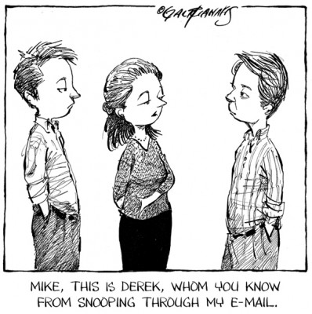
Translation
A breach is the compromise of the security of a client’s PHI or personal information (APIPA)
Unauthorized use – an impermissible use or disclosure of PHI
Common Breaches:
It is very common for someone to be nosey and look at information that has nothing to do with their job. (i.e. – neighbor is in hospice care so looks at client file).
Fax containing PHI sent to wrong fax machine.
Texting PHI
Email containing PHI sent outside of CCS email system.

Slide 27
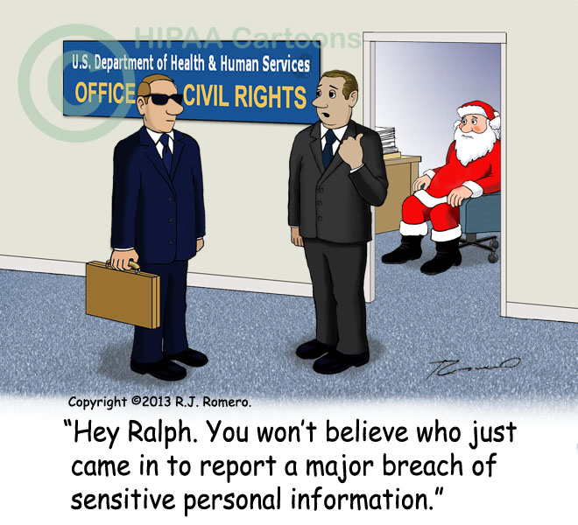
Oops! A Breach Happened!
If a Breach happens, Report it IMMEDIATELY to the Privacy Officer using the Incident Report Form.
Provide as much detail as possible.
The Privacy Officer must conduct an investigation and report the breach to the Office of Civil Rights.
It is not up to you to conduct the investigation.
Notes:
-It is not up to you to do an investigation
-If you think a breach happened – yourself or a coworker – it must be reported as soon as you find out about it

Slide 28

How Do I Keep PHI Secure?
The Security Rule and the Alaska Personal Information Protection Act require agencies to use reasonable safeguards to protect electronic PHI (ePHI) and electronic personal information (ePI).
The rules are intended to protect the confidentiality, integrity and availability of ePHI and ePI.
They are also intended to protect ePHI against any reasonably anticipated threat or hazard, and improper use or disclosure.
Means used to keep ePHI and ePI secure:
Encryption, Encryption, Encryption
Do not send ePHI and/or ePI by means that does not encrypt

Slide 29
So what?
Is this why we must change our computer log-on so frequently? ANSWER: yes
Does this mean that I can’t text ePHI or ePI?
ANSWER: Yes that is correct. You CANNOT text ePHI or ePI.
Can I email the State about a clients plan of care?
ANSWER: You can email the State if you use the State’s Direct Messaging System (DSM). You CANNOT use Groupwise.
What if I accidentally send ePHI or ePI in a Groupwise email outside of the agency?
ANSWER: Report it immediately to the Privacy Officer.

Slide 30

Helpful Privacy Tips
Think before you share PHI, PI, ePHI and/or ePI whether it is verbal, written, or electronic.
Only access or share the MINIMUM NECESSARY to get your job done. Everything else must be kept secure.
Don’t leave PHI on your desk, in your car, etc. unsecure; especially when you leave at night. This is one of the number one means for a breach.
Never share your password, even with IT.
Consider where your computer monitor is located. Can others see your screen and access ePHI or ePI? If so, ask for a privacy screen from IT.
Don’t open attachments from unidentified senders.

Slide 31
Helpful Privacy Tips
PHI must be protected and secure when it travels even in ePHI form. That is why you cannot text as it is not secure.
Papers containing PHI or PI should NEVER go in the trash. The best way to dispose is to shred by using a crosscut shredder.
All PHI or PI, whether in paper or electronic form need to protected even when you don’t need it any longer. You need to consider what is stored on your mobile device.
Limit PHI or PI on whiteboards, chart holders, etc. especially in areas that can be seen by others.
Immediately report lost or stolen devices to the Privacy Officer.
Know when to call the Privacy Officer for help. Don’t guess when you are unsure how to handle a situation.

Slide 32

More Helpful Privacy Tips
All emails that contain PHI or PI sent through Groupwise to a non-Groupwise email must be encrypted. Remember that initials are considered PHI.
Remember that text messages are not encrypted. Sending PHI through text is considered a breach.
If an outside source sends you an email containing PHI, it is considered a breach if you respond to that email by hitting “reply”.
You must start a new email and not include any PHI in order to respond.

Slide 33

How Much Does This Really Matter?
Failure to comply with all of the privacy and confidential rules and regulations may result in civil and criminal penalties and sanctions by the government – both State and Federal.
Sanctions can involve money and jail time.

Slide 34
HIPAA Take Aways
Consider – is using or disclosing this client information in the best interest of the client?
Stop and Think –
before sending an email outside of the Groupwise system. Does the email contain one of the 18 protected identifiers (including initials) or personal information? If so, don’t send.
Before sending a text ensure it does not include any PHI or PI (including photos). If so, don’t send.
When in doubt, contact the Privacy Officer. Don’t second guess. There are no penalties for asking!
Know who the Privacy Officer is – Jennifer Carson

Slide 35
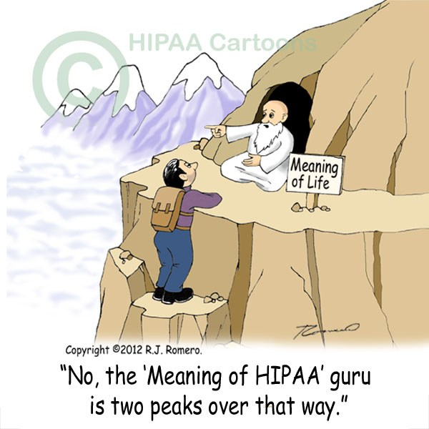
Questions?

